Slide 1


connecting an organization over remote areas
group code : SHR1_ISS2_M1e
Training company : AST
Trainer : Sameh elshemy

Slide 2
Team members :
Poula george fouad
Kamal sabry mohammed
Mohammed abdelnasir elsaid shetewey
Omar fathi Mohammed
Software used :
Cisco packet tracer

Slide 3
Main idea
We aim to connect a big business with up to 10 buildings with a powerful , secure and expandable network , using advanced network devices and topologies
Implemented with 1 big Lan with 3 main departments , 1 Lan over another building contains server room , 1 another building contains the IT department Lan
Could be expanded with business needs in mind , and have fast networking up to 10 Gb/s speeds thanks to fiber optics connections

Slide 4
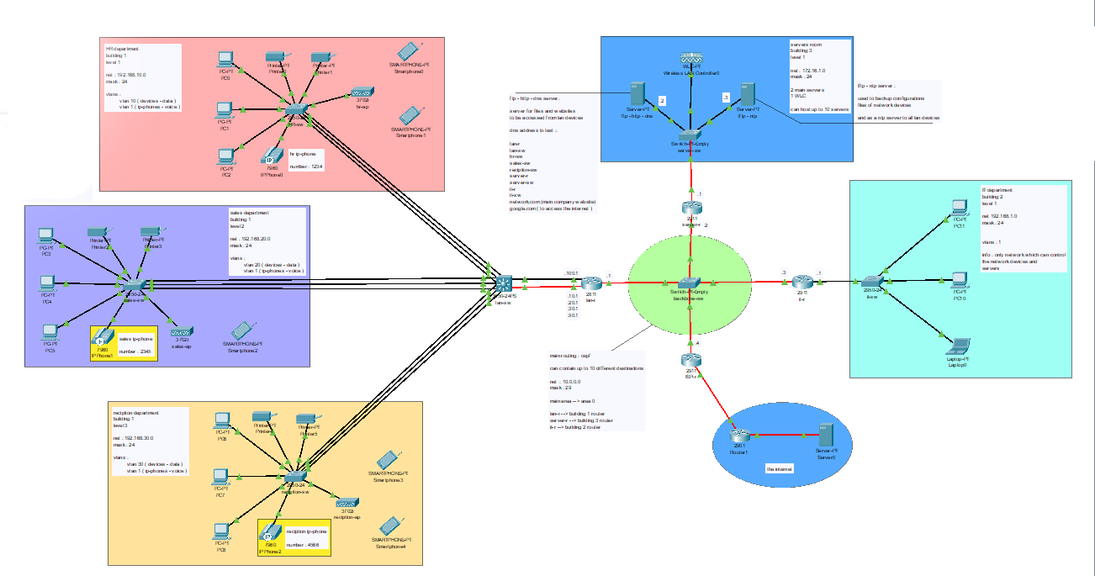
Lan topology:
In this topology implementation …
5 main areas
Central backbone area
Predefined area to access the wan
Wan connection

Slide 5
Lan section:
We have 3 main departments :
HR dep. : network → 192.168.10.0
Sales dep. : network → 192.168.20.0
Reciption dep. : network → 192.168.30.0
Each dep. Have 3 types of devices :
Data devices : PCs , printers , AP , etc.
Voice devices : Ip-phones
Network devices : department switch

Slide 6
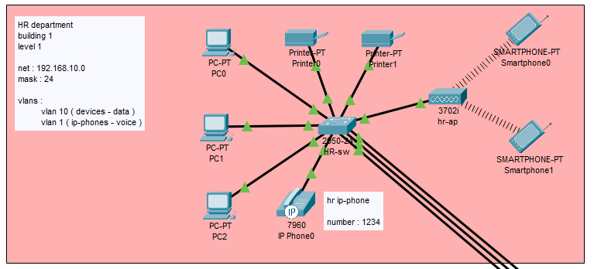
HR dep. : ( building 1 , level 1 )
Department for HR employees
Network id : 192.168.10.0 ( data )
Network id : 192.168.50.0 ( voice )
Can have up to 10 PCs and 10 Ip-phones without any extra cost as no additional devices needed.
For future upgrades we can have up to 254 data devices and up to 84 voice devices like Ip-phones.
( added switches only may be needed )
Have a separate access point to connect wireless devices like laptops and smartphones ( ssid : HR-ap / password : 12345678)

Slide 7
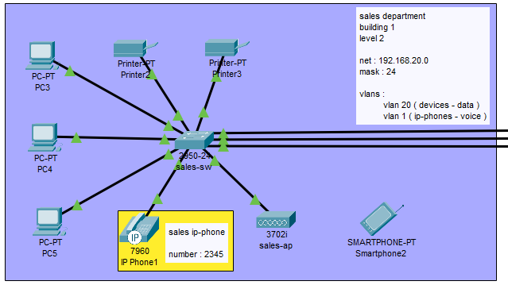
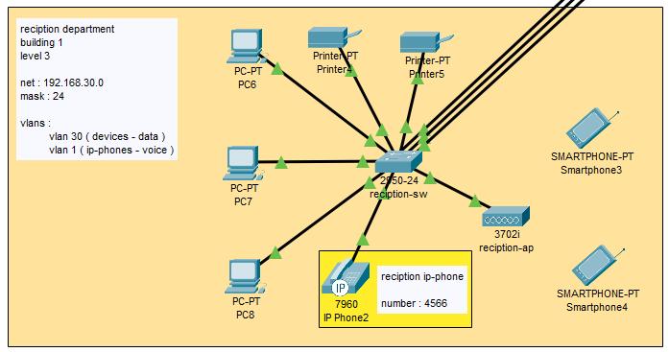
Sales & reception dep. : ( building 1 , level 2 & 3 )
Both have same basic configuration as the HR dep. With separate access points with different names and passwords
Sales net : 192.168.20.0/24 reception net : 192.168.30.0/24
Have same max number of devices and same expandability with added switches id needed

Slide 8
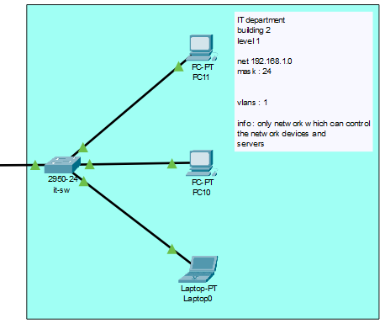
IT dep. : ( building 2 , level 1 )
This department is the only one which can access routers and switches remotely via services like telnet or ssh
Net : 192.168.1.0 /24
Can be expanded to 24 devices without the need of any extra hardware or switches .
Can have up too 254 device with extra switches only connected and configured
No wireless connectivity here for added security .

Slide 9
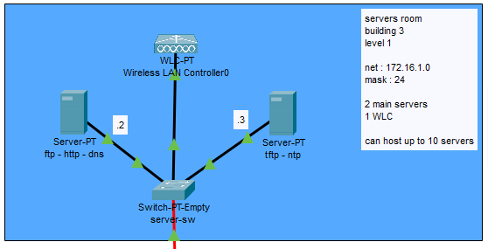
Servers room : ( building 3 , level 1 )
A room specified for servers and network controllers and firewall devices .
Net : 172.16.1.0 /24
In this configuration we have 2 main servers and 1 wireless lan controller.
And can be expanded up to 9 different servers without extra hardware needed
Server 1 : for web services , ftp file sharing and dns server for all network devices and clients ( add 172.16.1.2 )
Server 2 : for ntp server to sync network devices & a tftp server to backup configuration files of the main routers and switches ( net : 172.16.1.3 )

Slide 10
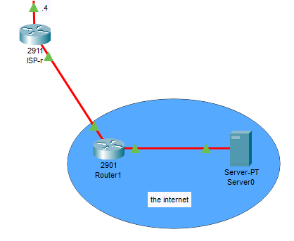
Wan gateway :
A separate router as a gateway to the wan network and connect local deices and clients to the internet.
Only type “ google.com “ in any web browser to access the web.

Slide 11
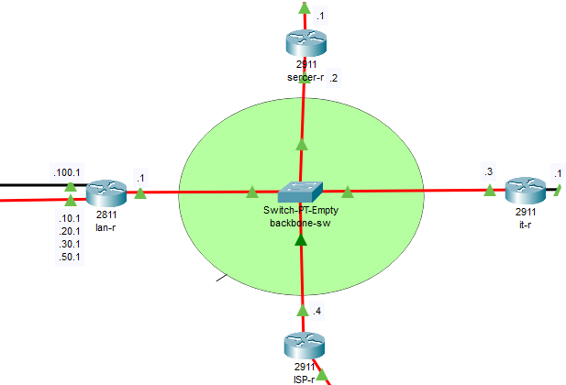
Backbone area :
To server room
What connects all the destinations of the network together .
Stretched over long distances thanks to fiber connection with provides fast speeds and long reliable distances.
Contains 4 main routers.
Lan-r : → connect building 1
It-r : → connect building 2
Server-r : → connect building 3
To HR , sales , reception departments
To IT department
Easily expandable as we can connect up to 10 different destinations and buildings including the wan without any added hardware

Slide 12
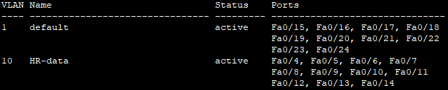
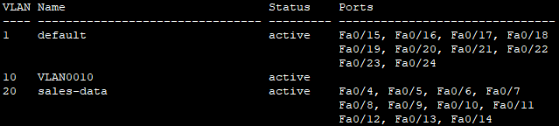
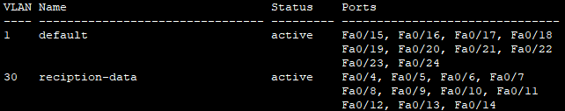
Network features :
Vlans:
As to isolate the devices and keep a high level of security , we configured 2 main vlans for any lan device
Vlan 1 → for voice devices like Ip-phones
Vlan 10 or 20 or 30 → for data devices like PCs
Can be expanded easily to add more types of devices like security cameras or smart IOT devices

Slide 13
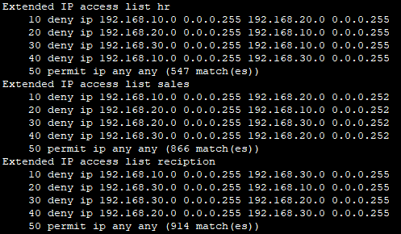
Network features :
ACLs :
As we want high secured network and highly controlled environment , we added features like access control lists .
In this implementation we configured it in way that department devices can only talk to outside servers and can not talk or ping with other departments devices.
Only voice devices can talk with each other and not constrained with the department

Slide 14
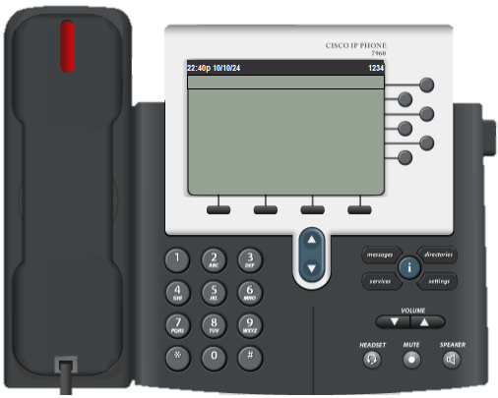
Network features :
IP-phones :
To achieve a network that is useful on the field and not only in simulations we have to add support for voice devices like IP-phones.
So, each department can have up to 10 IP-phones one for each client and can be expanded easily with only added switches.
Int this configuration we have 3 phones …
Hr. phone → #1234
Sales phone → #2345
Reception phone → #4566

Slide 15
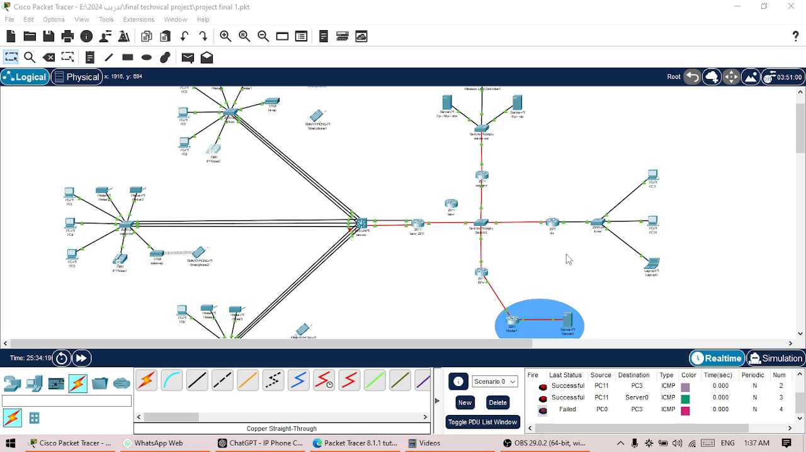
Network features :
IP-phones :
Using IP-phones
demo

Slide 16
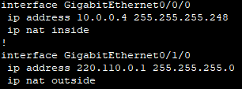
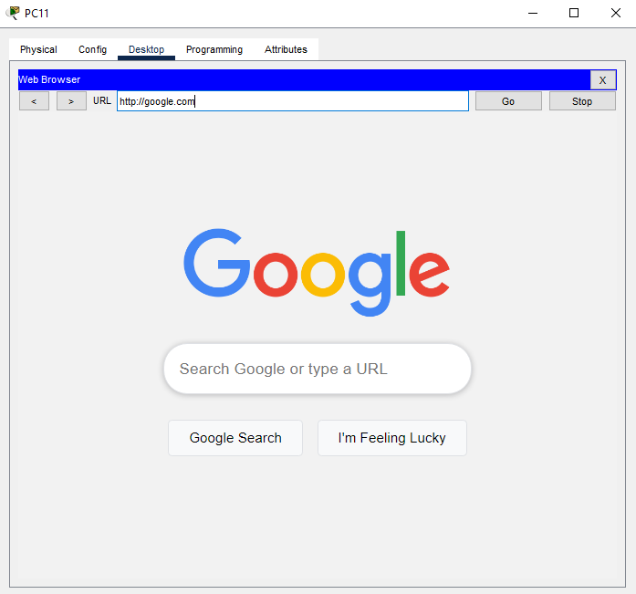
Network features :
NAT & WAN support:
As any network must access the internet, we supported the wan connections and added NAT addressing.
As you can see NAT is used to translate local IP addresses to a WAN Ip addresses so we can access the web for all devices with one public IP and non of the internal Ips is visible to the public.
You can access google by simply type :
“http:// google.com” in any web browser from any device.

Slide 17
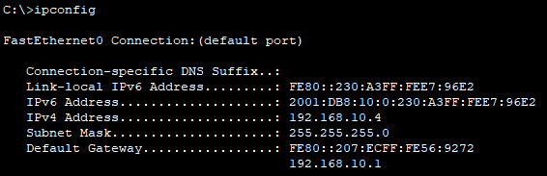
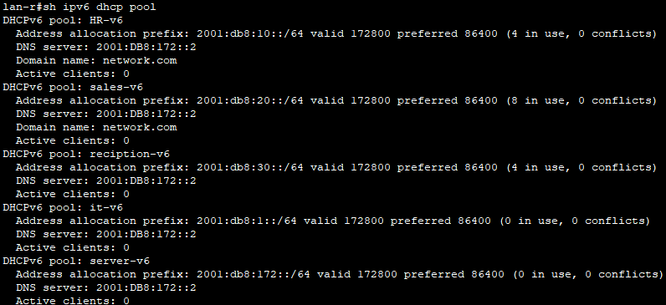
Network features :
IPv4 & IPv6 support :
We aim to a fully future prof network, so we fully support IPv4 and IPv6 addressing and routing.
All client devices equipped with 2 addresses one is IPv4, and the other is IPv6.
We added support for OSPFv2 and OSPFv3 for dynamic routing between all routers.
So, no addressing bottlenecks in the future at all.

Slide 18
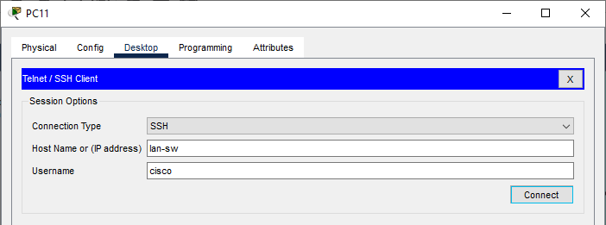
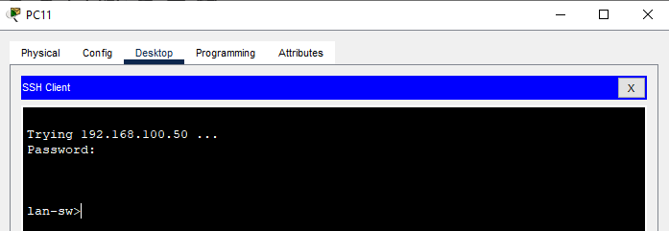
Network features :
Remote accessing :
We want any device to be accessible to the right people so we support SSH terminal for all network devices and can be accessed only via the IT clients.
We can simply write the device name ( ex : lan-r / HR-sw / server-sw ) and access them with secured username and password.
In this simulation topology, we unified username and password to be cisco and 1234, respectively.

Slide 19
Thank you

